Slide 1
Chapter 11
Pointer
Applications

Slide 2
Pointer Applications
Arrays
Dynamic Memory

Slide 3
Pointer Applications
Arrays and Pointers
The name of an array is a pointer constant to the first element
Since the array name is a pointer constant to the first element
  its value cannot be changed
  the address of the first element and the name of the array both represent the same location in memory
  we can use the array name anywhere we can use a pointer, as long as it is used as an rvalue
  we can use it with the indirection operator

Slide 4
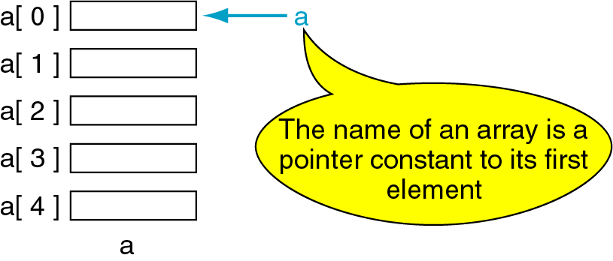
Figure 11-1 Pointer to Arrays

Slide 5
Arrays and Pointers
When we dereference an array name . . .
we are dereferencing the first element of the array & not the whole array
a is same as &a[0]
Program: demonstrate that array name is a pointer constant
Print the address of the first element of the array and the array name
    int a[5];
    printf(“%p %p”, &a[0], a);
Note: both values will be same

Slide 6
Dereference of Array name
Variation – prove that the array name is a pointer constant to the first element of the array
Program: Demonstrate by printing the value in the first element of the array using both a pointer and an index

Slide 7
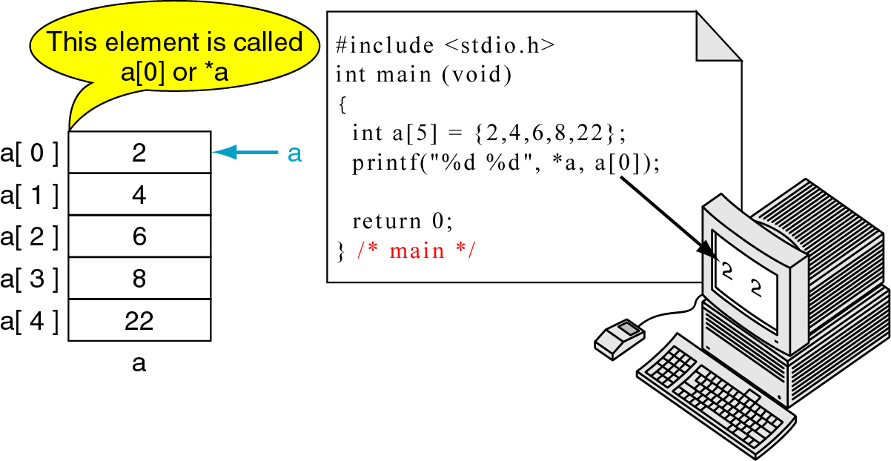
Figure 11-2 Dereference of Array name

Slide 8
Array names as pointers
If the name of an array is a pointer, show that we can store this pointer in a pointer variable and use it in the same way we use the array name
Define and initialize the array
Define a pointer and initialize it to point to the first element of the array by assigning the array name
Print the first element in the array using both index and pointer notations
Note: the array name is unqualified. There is no address operator or index

Slide 9
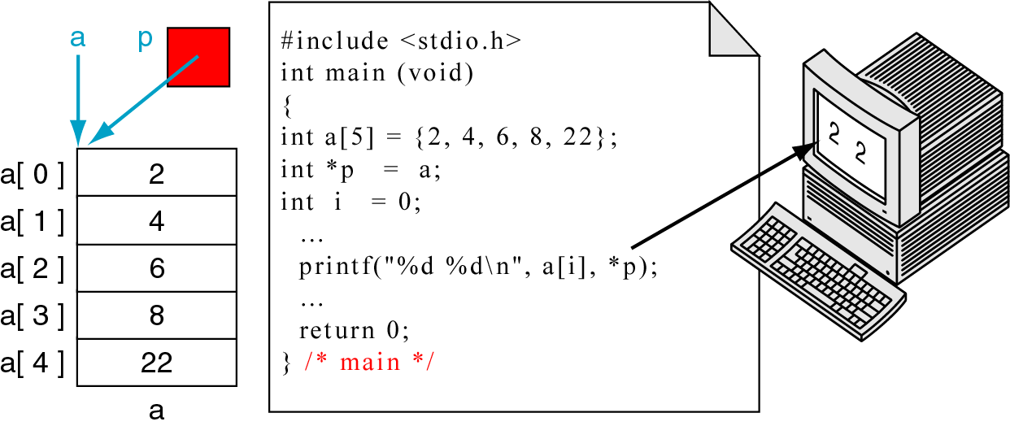
Figure 11-3 Array names as pointers

Slide 10
Array and a pointer
Program: demonstrate the use of multiple names for an array to reference different locations at the same time
1) by an array name
2) create a pointer to integer and set it to the second element of the array a[1]
This pointer can be used as an array name and can be indexed
Print the first 2 elements using array name as well as by pointer
Note: negative index

Slide 11
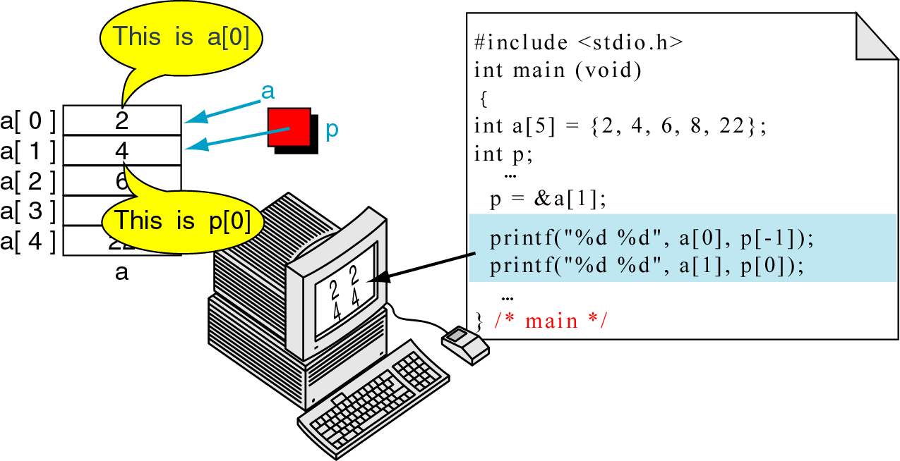
Figure 11-4 Multiple Array Pointers
To access an array, any pointer to the first element can be used instead of the name of the array
Notes:
Error: Line no. 5 should be int *p;

Slide 12
Pointer Arithmetic and Arrays

Slide 13
Pointer Arithmetic and Arrays
Moving through an array:
  indexing
  Pointer Arithmetic
Pointer Arithmetic: offers a set of arithmetic operators for manipulating the addresses in pointers
Powerful for moving element by element in an array (search sequentially)

Slide 14
Pointers and One-Dimensional Arrays
If we have an array, a, then
  a is a constant pointing to the first element
  a+1 is a constant to the second element
If p is a pointer pointing to a[1], then
  p-1 is a pointer to the previous (first) element
  p +1 is a pointer to the next (third) element
Generalizing:
Given pointer p, p + n or p-n is a pointer to the value n elements away

Slide 15
Pointers and One-Dimensional Arrays
As long as a or p are pointing to one of the elements of the array
  we can add or subtract to get the address of other elements of the array

Slide 16
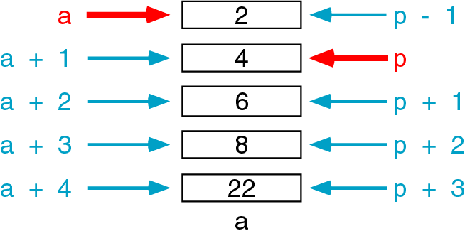
Figure 11-5 Pointer Arithmetic
Different from normal arithmetic
Adding an integer n to a pointer value gives a new value that corresponds to an index location, n elements away
So n is an offset from the original pointer

Slide 17
Pointers and One-Dimensional Arrays
To determine the new value, C must know the size of one element
The size of element is determined by the type of the pointer
This is the reason why pointers of different types cannot be assigned to each other

Slide 18
Pointers and One-Dimensional Arrays
If offset is 1:
  C will add or subtract one element size from the current pointer value
  access is more efficient than corresponding index notation
If offset is more than 1:
  C must compute the offset by multiplying the offset by the size of one array element and adding it to the pointer value as below:
  address = pointer + (offset * size of element)
  Depending on the hardware the multiplication can make it less efficient than simply adding 1
  So pointer arithmetic is not efficient compared to indexing
  a + n becomes a + n * (sizeof(one element))

Slide 19
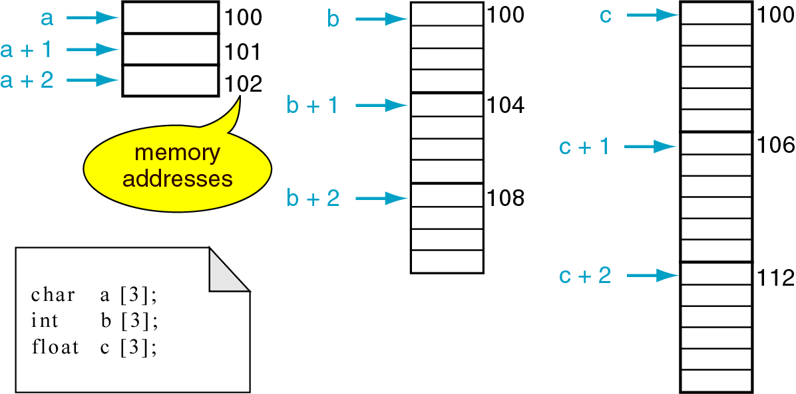
Figure 11-6 Pointer Arithmetic and different types
Pointer arithmetic on different sized elements

Slide 20
Pointer arithmetic on different sized elements
a+1means different things:
char takes 1 byte:
  Adding 1 moves to the next memory address (101)
Integer taking 4 bytes:
  Adding 1 to array pointer b moves to 4 bytes in memory (104)
Float taking 4 bytes:
  Adding 1 to array pointer c moves to 4 bytes in memory (104)
Note: size is compiler dependent

Slide 21
Pointers and One-Dimensional Arrays
We have seen how to get the address of an array element using a pointer and an offset
How can we use that value?
1) we can assign it to another pointer
p = arrayName + 5;
2) use with indirection operator to access or change the value of the element we are pointing to

Slide 22
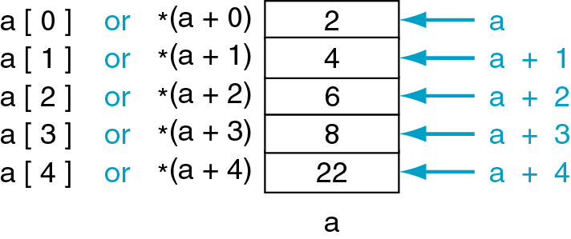
Figure 11-7 Dereferencing array pointers
a[n] and *(a+n) are identical expressions

Slide 23
Program to find the smallest number
Find the smallest number among 5 integers stored in an array
pSm is set to the first element of the array
pWalk is working pointer pointing to the second element
Working pointer advances through the remaining elements
Compares current element with element pointed to by pSm & assigning smaller to pSm

Slide 24
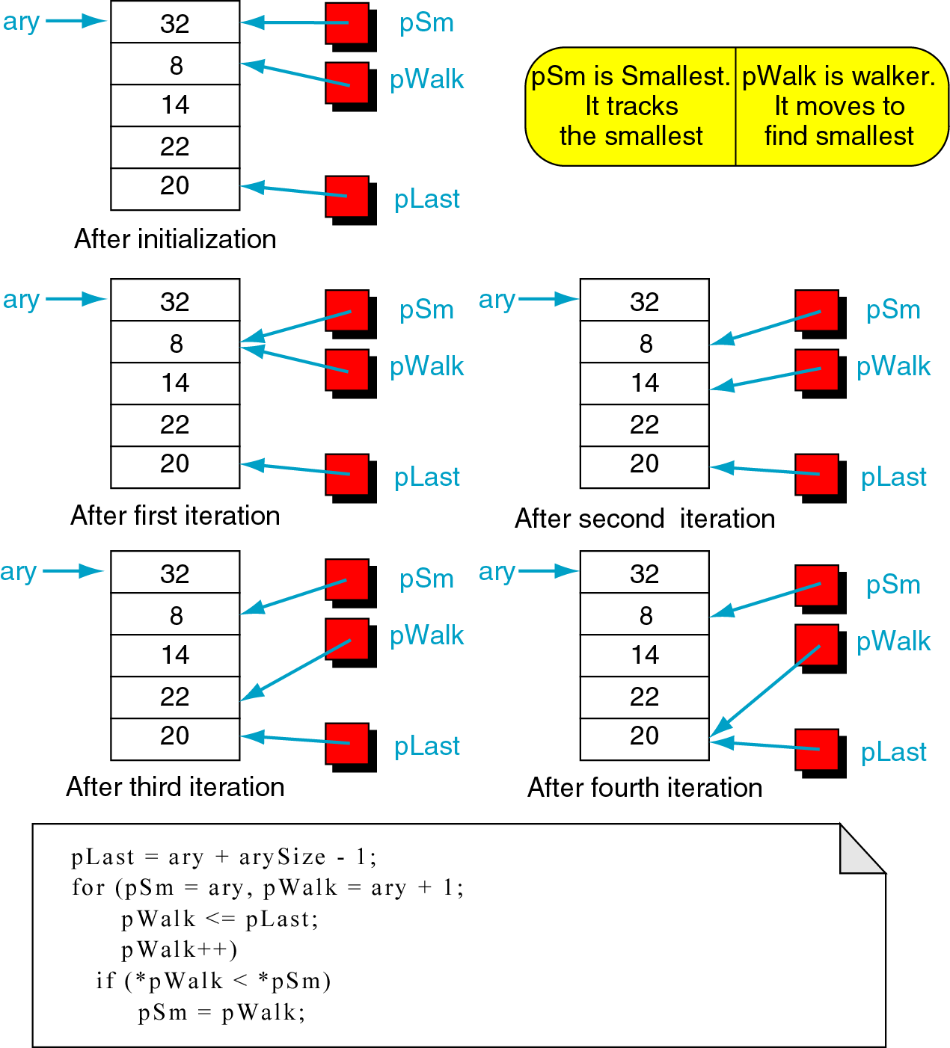
Figure 11-8 Find smallest

Slide 25
Figure 11-8 Find smallest

Slide 26
Arithmetic Operations on Pointers
Arithmetic operations involving pointers
Addition can be used when one operand is a pointer and the other is an integer
Subtraction can be used only when both operands are pointers or when one operand is a pointer and the other is an index integer
Note: result is meaningful only if the two pointers are associated with the same array structure
Also, pointer with postfix and unary increment and decrement operators are valid
Ex: p+5, 5+p, p-5, p1-p2, p++, --p are valid

Slide 27
Pointers and other operators
Relational operators involving pointers
Allowed only if both operands are pointers of the same type
Ex: pointer relational expns
P1 >= p2 , p1 != p2
If(ptr != NULL) same as if(ptr)
If (ptr == NULL) same as if(!ptr)

Slide 28
Using Pointer Arithmetic

Slide 29
Using pointer arithmetic
Program: demonstrate moving through array using pointers forward and backward

Slide 30
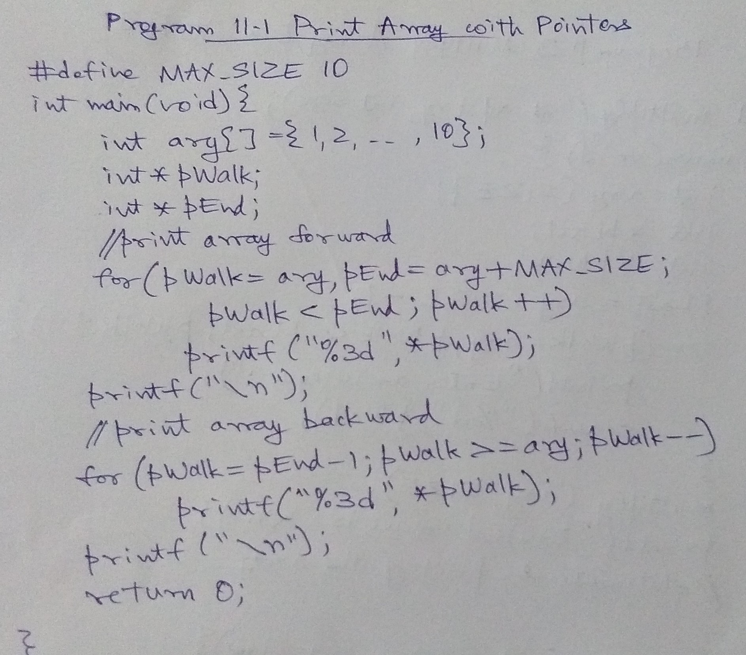
Using pointer arithmetic

Slide 31
Binary search
Find 22 in a sorted array: 12 is the size of list
List: { 4, 7, 8, 10, 14, 21, 22, 36, 62, 77, 81, 91}

Slide 32
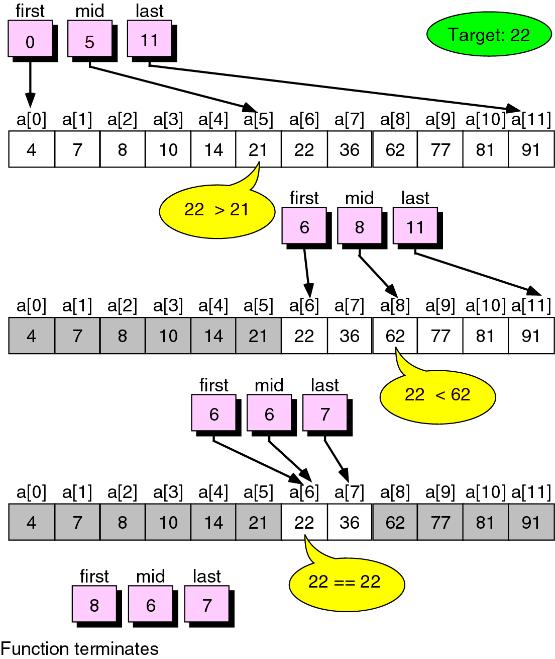
Figure 8-26 binary search example

Slide 33
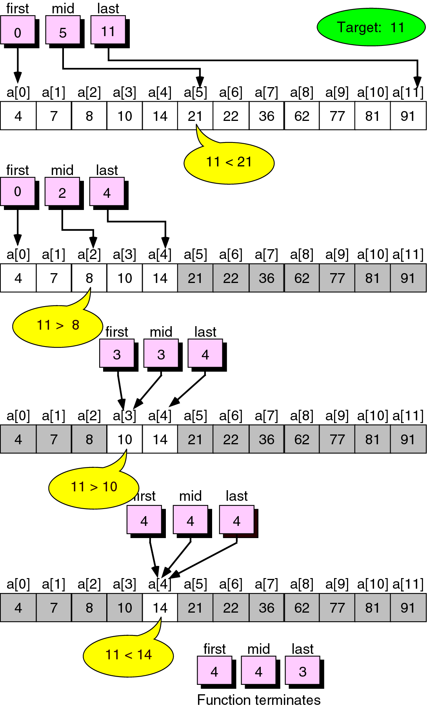
Figure 8-27 Unsuccessful binary search example

Slide 34
Background on 2D arrays

Slide 35
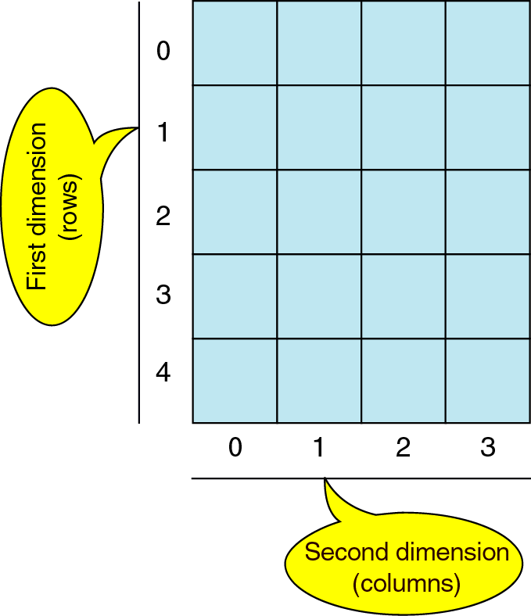
Figure 8-28 2D Array

Slide 36
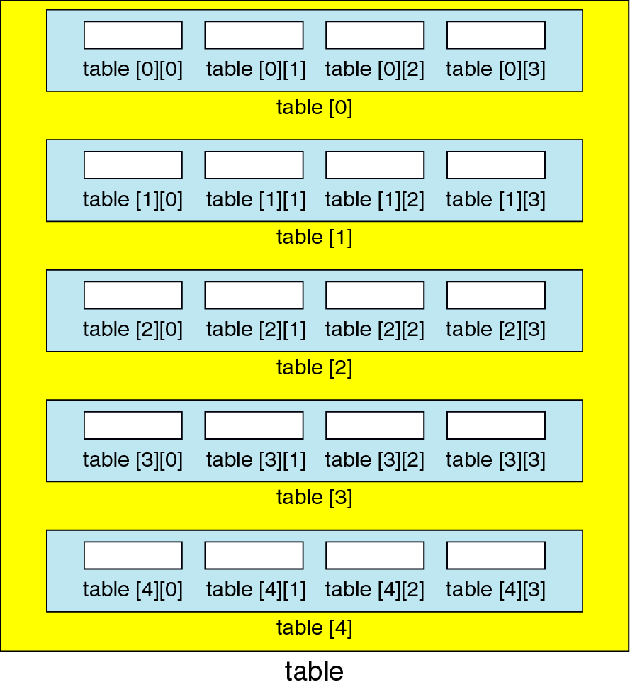
Figure 8-29 Array of arrays

Slide 37
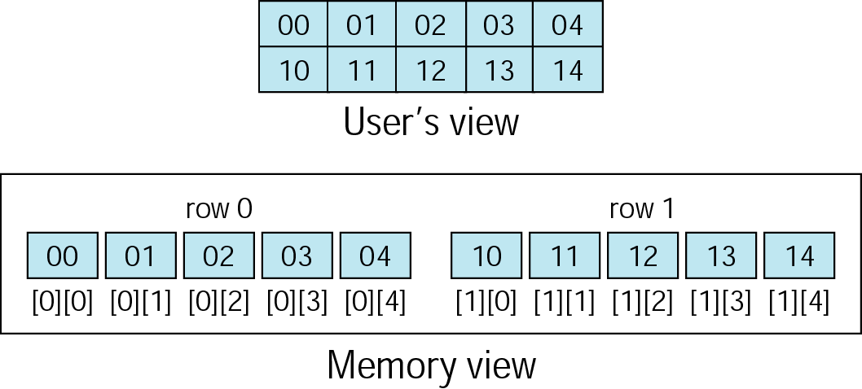
Figure 8-30 Memory Layout

Slide 38
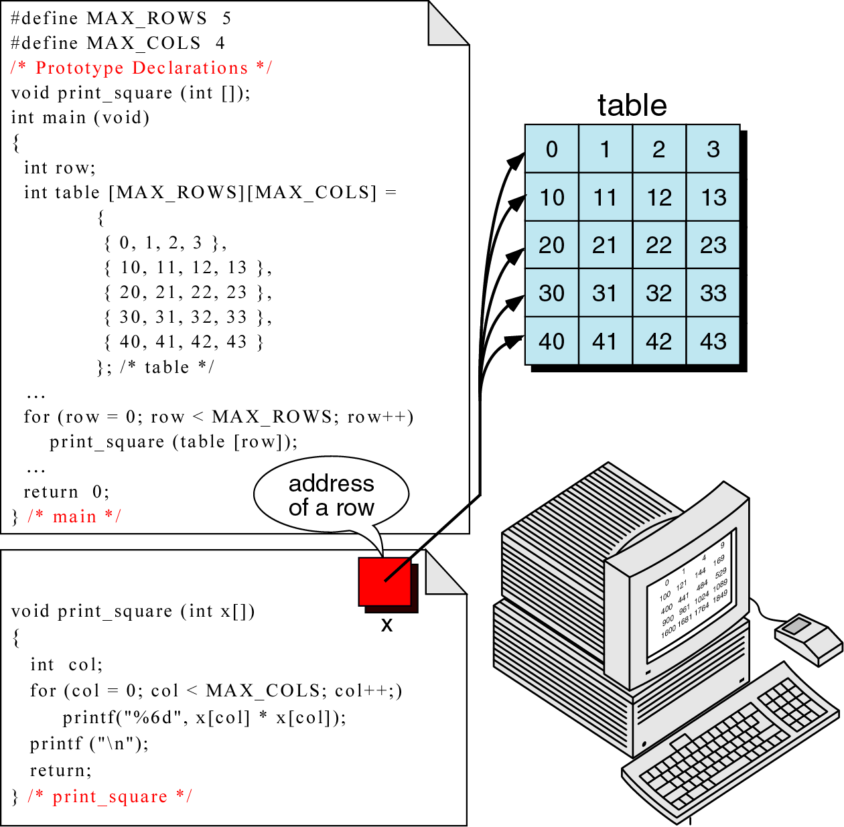
Figure 8-31 Passing a row

Slide 39
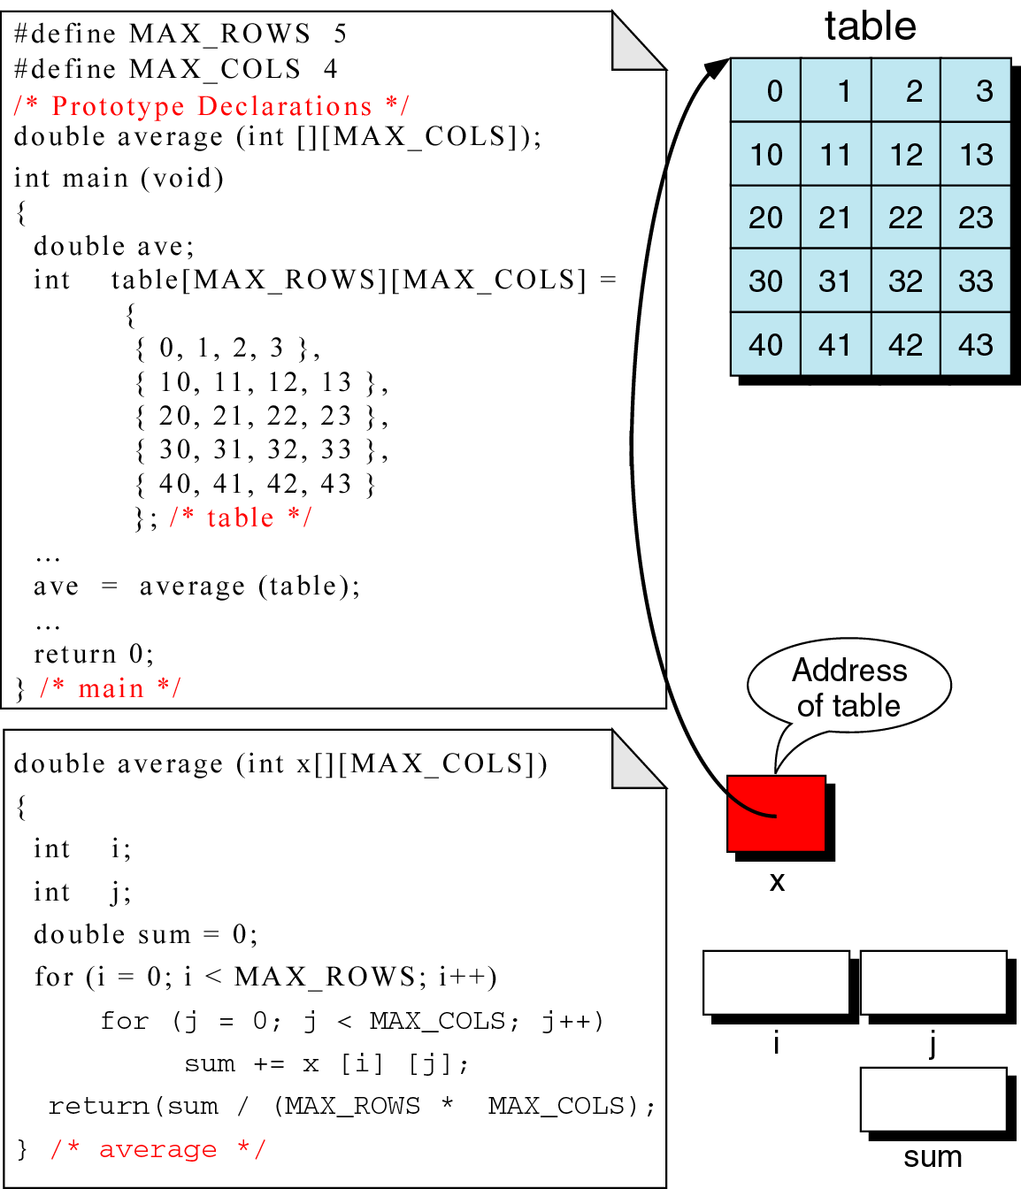
Figure 8-32 Calculate average of integers in array

Slide 40
Pointers to 2D arrays

Slide 42
Pointers to 2D arrays
Just as in 1D array, the name of the array is a pointer constant to the first element of the array
Here, the first element is another array
Suppose, we have an array of integers
For a 2D array, when we dereference the array name, we get an array of integers (we do not get one integer)
So, dereferencing of the array name of a 2D array is a pointer to a 1D array

Slide 43
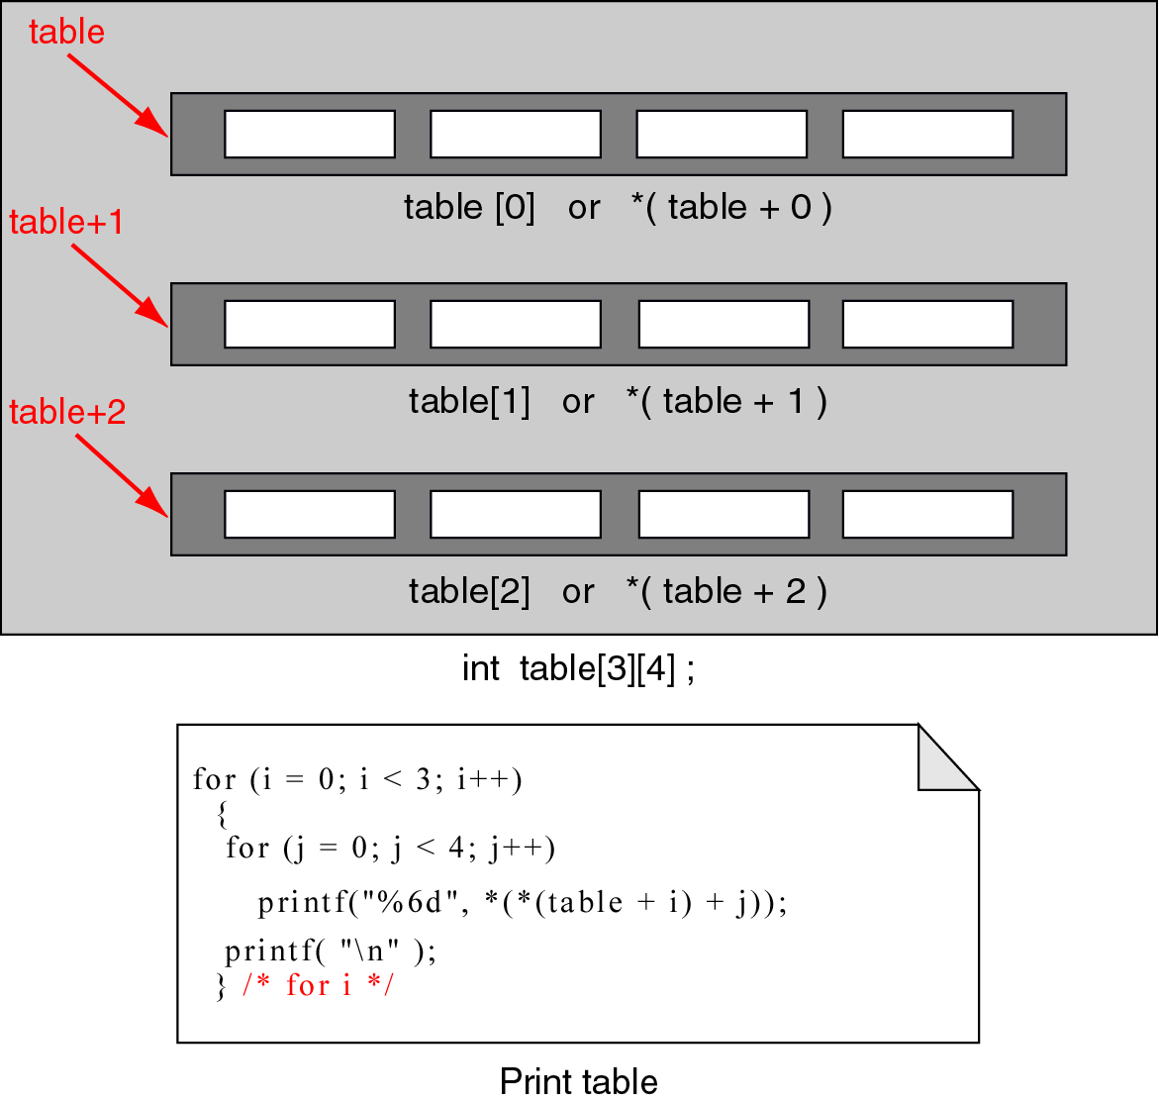
Figure 10-9 Pointers to 2D arrays

Slide 44
Pointers to 2D arrays
In the figure, each element is shown in both index and pointer notation
  table[0]: refers to an array of 4 integer values
  *(table+0) : equivalent pointer notation is by dereferencing the array name
Program: demonstrate pointer manipulation with 2D array by printing the table
  To refer to a row: dereference the array pointer which gives us a pointer to a row
  Given a pointer to a row, to refer to an element, dereference the row pointer
  So it leads to double dereference as *(*(table))

Slide 45
Pointers to 2D arrays
The double dereference *(*(table)) : refers only to the first element of the first row
To step through all the elements, we need 2 offsets:
  One for the row
  Another for the element within the row
i and j: loop counters for offsets
Same logic as printing 2D array using indexes
  table [i][j]: index notation
  *(*(table+i)+j) : pointer notation
Note: With multi-dimensional arrays, the pointer arithmetic is not efficient over indexing
As it is complex, index notation is preferred

Slide 46
Passing an array to a function
If array name is a pointer to the first element, we can pass the array name to a function
When we pass the array name, no need to use the address operator
The array name is a pointer constant, so the array name is already the address of the first element in the array
Ex: compute(list) // calling program
1) int compute(int ary[]) // 3 different syntax for called program

Slide 47
Passing an array to a function
2) int compute(int *arySalary) //needs documentation that array is passed
3) for a 3D array int compute(int bigary[][2][5]) //the compiler needs to know the size of dimension after the first to calculate the offset for pointer arithmetic

Slide 48
Passing an array to a function
Program: call a function to multiply each element of a 1D array by 2
The variables are shown next

Slide 49
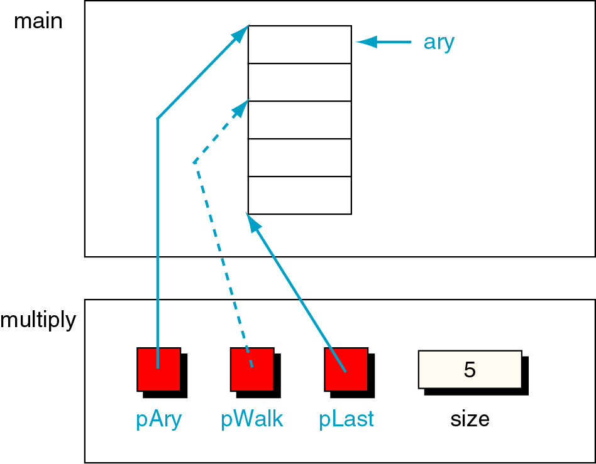
Figure 10-10 Variables for multiply array elements by 2

Slide 50
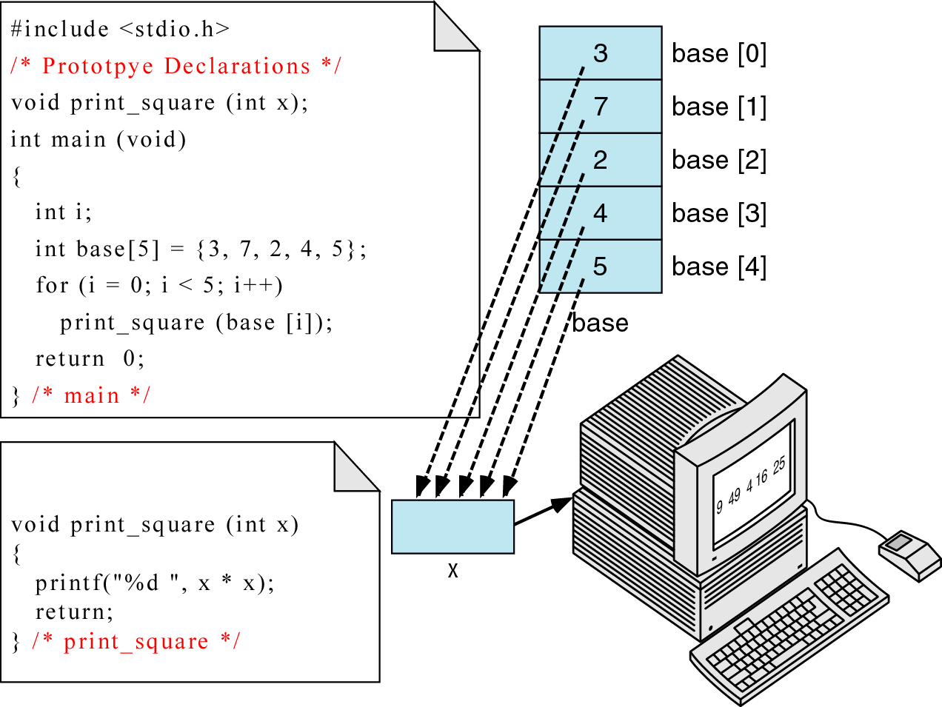
Figure 8-10 Passing individual elements

Slide 51
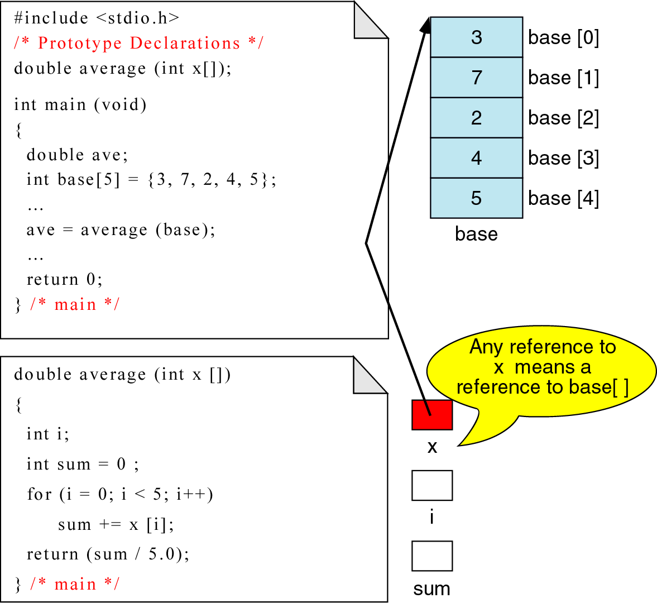
Figure 8-11 passing arrays

Slide 52
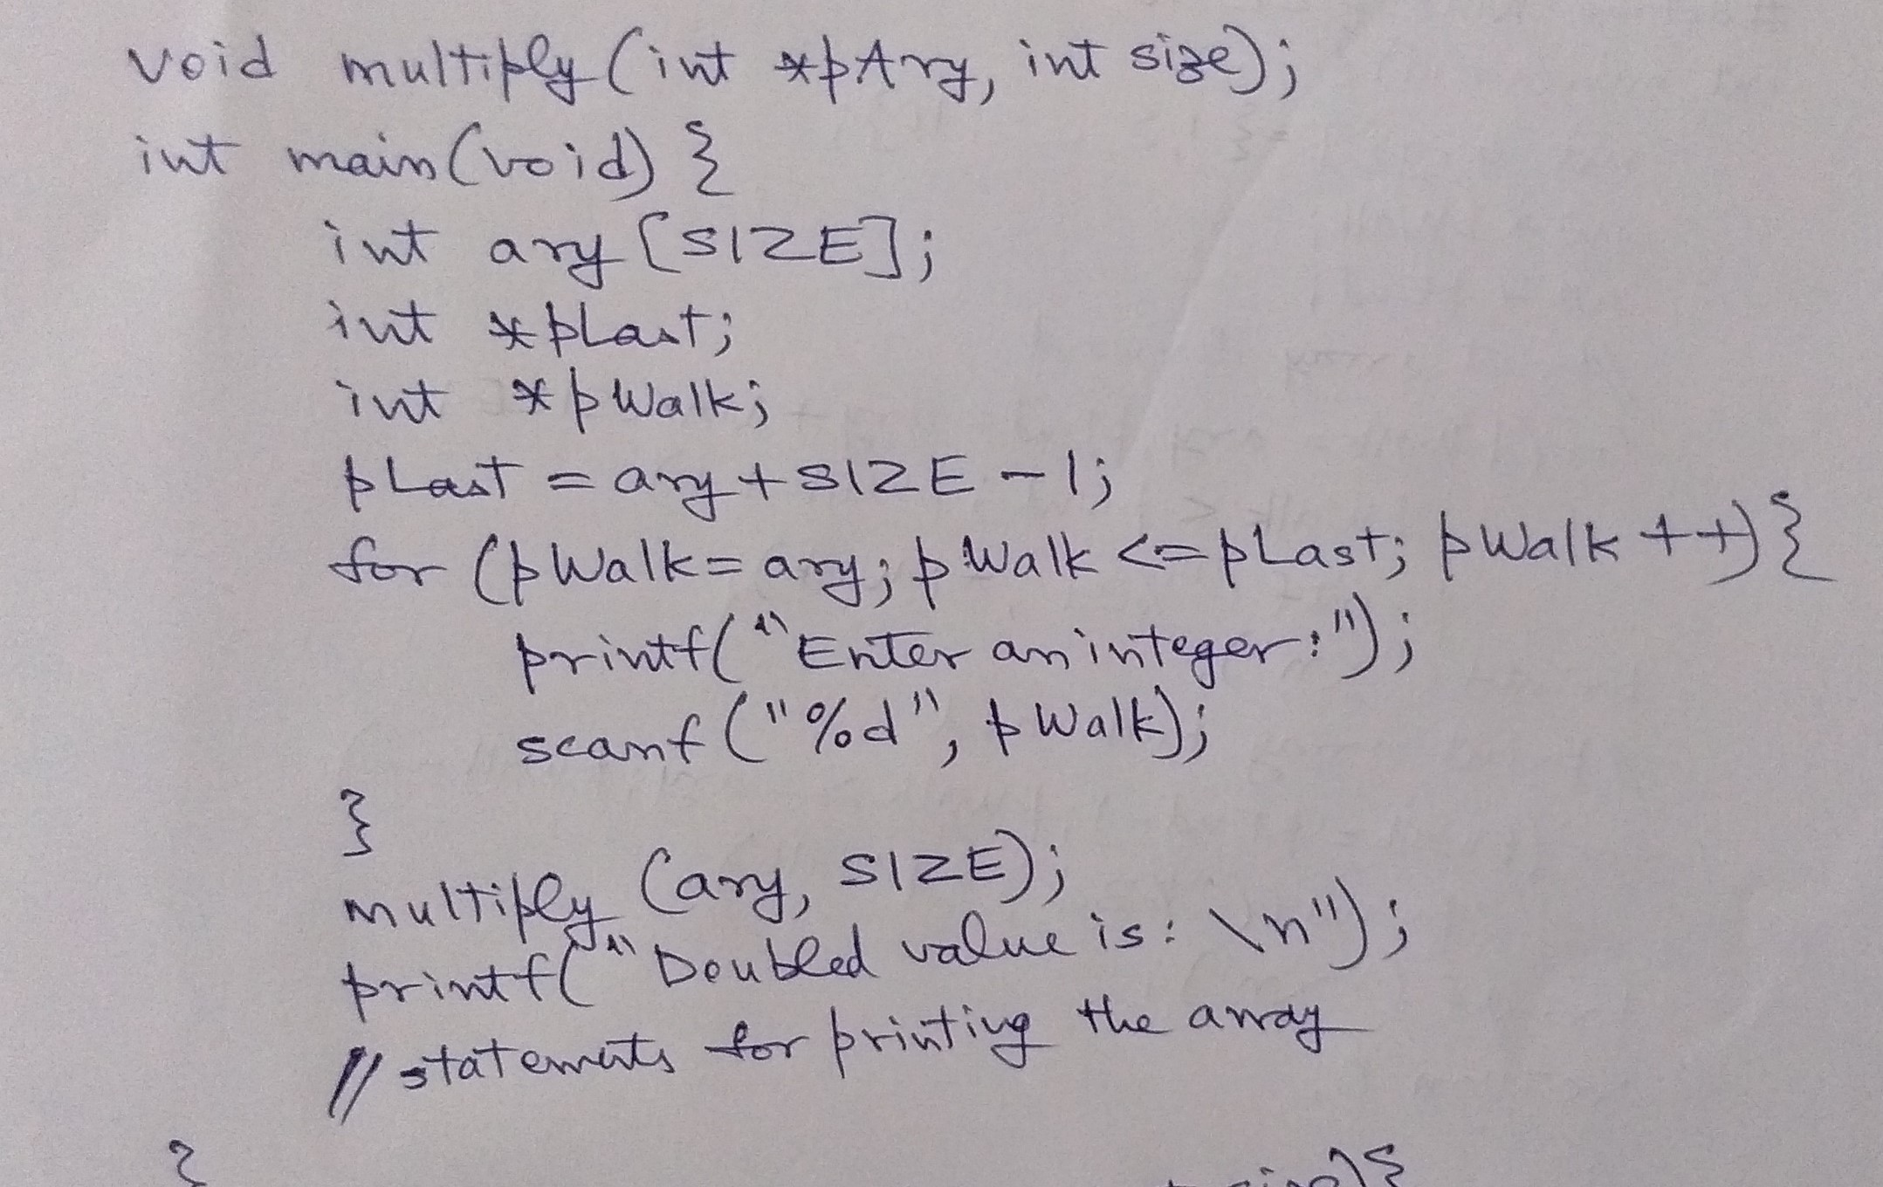
Passing an array to a function

Slide 53
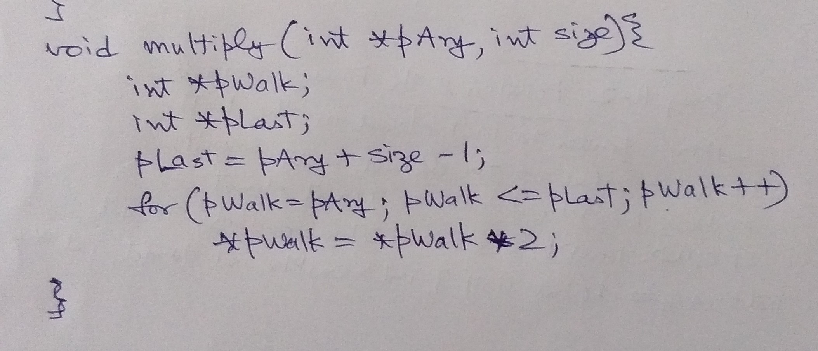

Slide 54
Understanding complex declarations

Slide 55
Understanding complex declarations
How to interpret declarations?
Use right-left rule

Slide 56
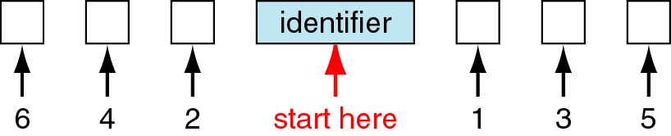
Figure 10-11 Right-left rule concept
Start with the identifier in the center of a declaration and read the declaration by alternatively going right and left until all have been read

Slide 57
Understanding complex declarations
How to interpret declarations?
Use right-left rule

Slide 58
Memory Allocation Functions

Slide 59
Memory Allocation Functions
Two choices to reserve memory locations for an object:
1. Static memory allocation
Requires that the declaration and definitions of memory be fully specified in the source program
The number of bytes reserved cannot be changed during run time
Works fine if the data requirements are exactly known
This is what we have done so far
Note: earlier PLs (FORTRAN, COBOL) had this limitation. The data structure need too be fully specified during compile time

Slide 60
Memory Allocation Functions
2. Dynamic memory allocation
Uses predefined functions to allocate and release memory for data while the program is running
Postpones the data definition to run time
Can be used either with standard data types or with derived data types

Slide 61
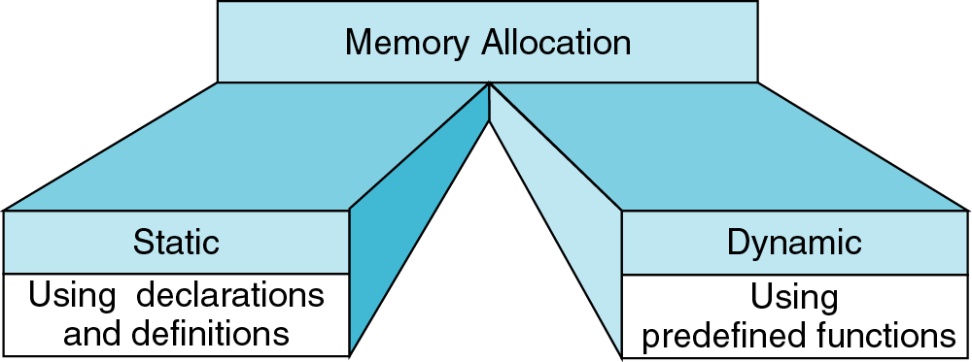
Figure 10-13 Memory Allocation

Slide 62
Understanding dynamic Memory Allocation
Conceptually memory is divided into program memory and data memory

Slide 63
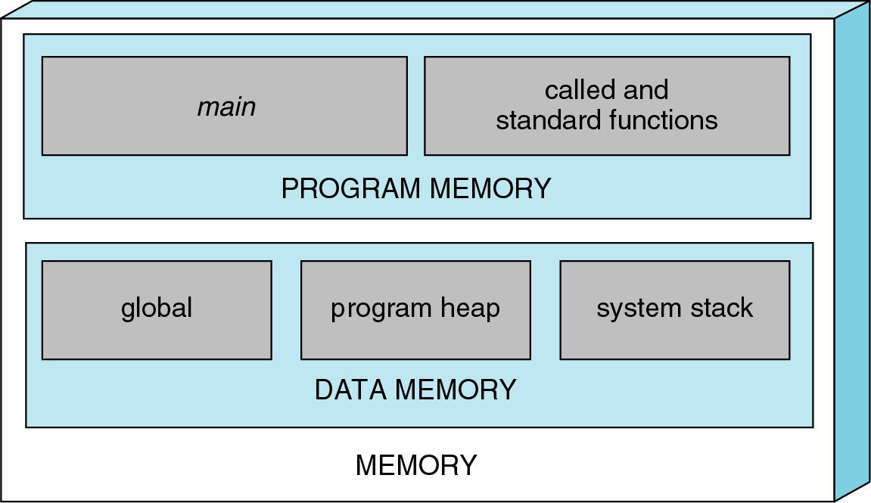
Figure 10-15 A conceptual View of memory
Note: implementation of memory is left to the designers who design the syste
Stack and heap can share the same pool of memory
So the above diagram is only conceptual

Slide 64
Understanding dynamic Memory Allocation
program memory:
Consists of the memory used for main and all called functions
data memory:
Consists of permanent definitions such as global data and constants, local definitions and dynamic data memory
Note: Exact ways of handling these needs will be decided by the OS and compiler

Slide 65
Understanding dynamic Memory Allocation
program memory:
Consists of the memory used for main and all called functions
main() must be in memory all the time
Each called function must be in memory while it is active
Note: any function has to be in memory when it is running

Slide 66
Understanding dynamic Memory Allocation
Memory allocation : stack
Although the program code for a function may be in memory at all times
  The local variables for the function are available only when it is active
In recursion, more than one version of the function can be active at a time
  Hence multiple copies of the local variables are allocated although only one copy of the function is present
The memory facilities for these capabilities is known as stack

Slide 67
Understanding dynamic Memory Allocation
Memory allocation : heap
Heap is unused memory allocated to the program
and available to be assigned during its execution
The memory pool from which memory is allocated when requested by the memory allocation functions

Slide 68
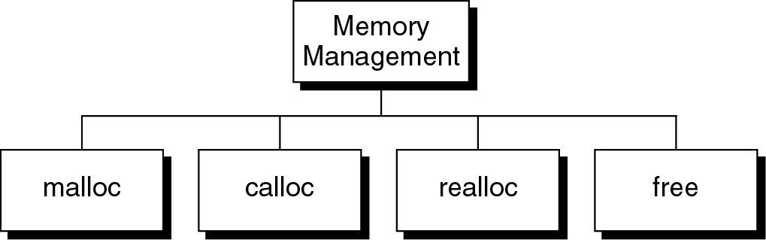
Figure 10-14 Memory Management Functions
Note: all memory management functions are defined in <stdlib.h>

Slide 69
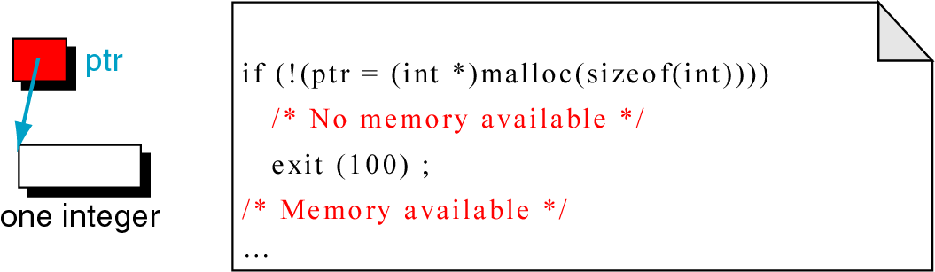
Figure 10-16 malloc (memory allocation)
Note: Allocates a block of memory that contains the number of bytes specified as the parameter
Returns a void pointer to the first byte of the allocated memory
The allocated memory is uninitialized (contains garbage)
To allocate an integer in the heap
pInt = (int *) malloc (sizeof (int));
The pointer returned by malloc is shown to be casted as an integer
For portability use sizeof()

Slide 70
malloc
Successful call
malloc returns the address of the first byte in the memory allocated
Unsuccessful call
malloc returns a NULL pointer
Overflow – attempt to allocate memory from the heap when memory is insufficient
Note: Refer to the memory allocated in the heap only through a pointer
It does not have its identifier

Slide 71
malloc
Allocating one integer object
If the memory allocated if successful, ptr contains a value
Else, no memory then exit with error code 100
malloc cannot be called with zero size (results are unpredictable, may return a NULL pointer or some other value)
Note: the program has to check for memory overflow
If it does not, the program produces invalid results
Required to terminate the program

Slide 72
calloc (contiguous memory allocation)
To allocate memory for arrays
1. allocates a contiguous block of memory to contain an array of elements of a specified size
Parameters – number of elements to be allocated, size of each element
2. Returns a pointer to the first element of the allocated array
Since it is a pointer to an array, the size associated with its pointer is the size of one element not the entire array

Slide 73
calloc (contiguous memory allocation)
3. calloc clears memory. So allocated memory is set to zero
The result is same for malloc and calloc for overflow and zero size

Slide 74
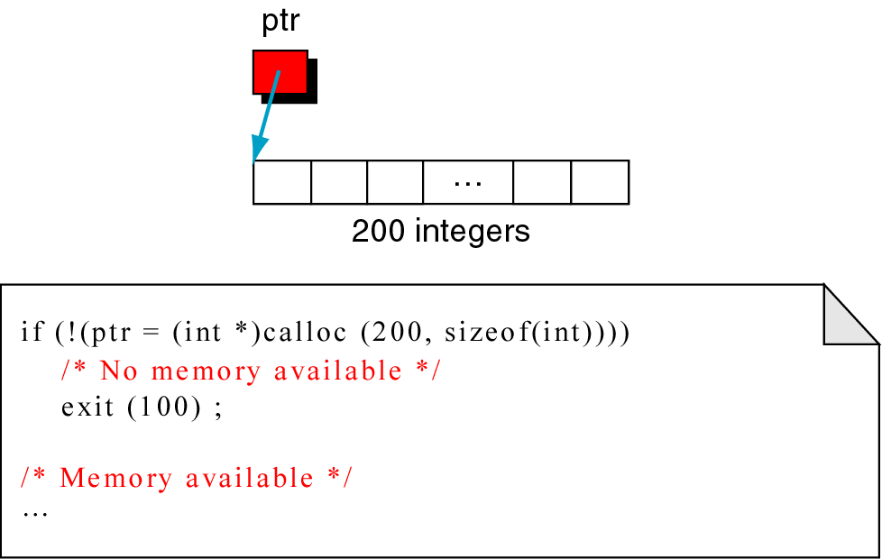
Figure 10-17 calloc
Allocating memory for an array of 200 integers

Slide 75
realloc (reallocation of memory )
Highly inefficient and to be used carefully
Given a pointer to a previously allocated block of memory,
  realloc changes the size of the block by deleting or extending the memory at the end of the block
  If the memory cannot be extended (due to other allocations), realloc allocates a completely new block
  Copies the existing memory allocation to the new allocation and deletes the old allocation
The programmer must ensure that other pointers to the data are correctly changed

Slide 76
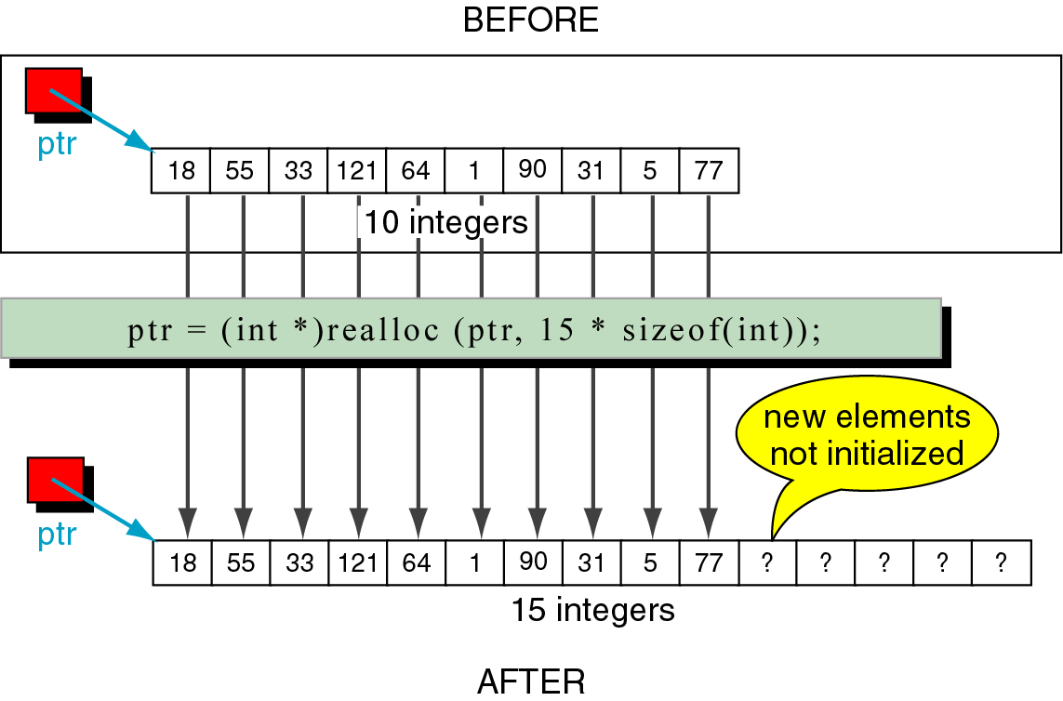
Figure 10-18 realloc

Slide 77
free (releasing memory)
When memory allocated by malloc, calloc, realloc are no longer needed
  They can be freed using free
It is an error to free memory
  With a null pointer or
  A pointer to other than the first element of an allocated block
  A pointer that is a different type than the pointer that allocated the memory
  To refer to memory after it has been released

Slide 78
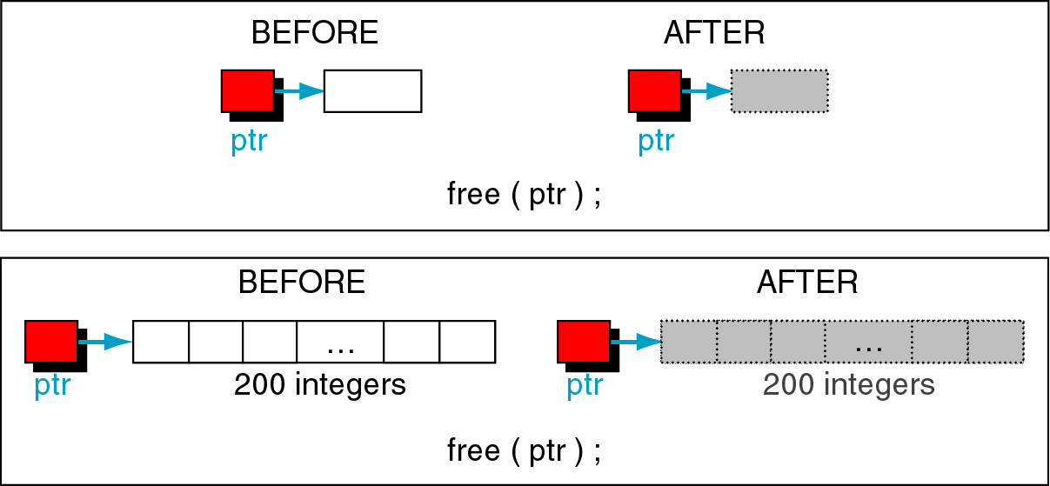
Figure 10-19 Freeing memory examples
Ex1: to release a single element allocated with a malloc back to the heap
Ex2: : to release a 200 element array allocated with a calloc, all 200 elements are returned back to the heap

Slide 79
free (releasing memory)
It is not the pointers that are being released but what they point to
To release an array of memory that was allocated by calloc, release the pointer only once
  Releasing memory does not change the value in a pointer
  It still contains the address in the heap
  It is a logical error to use the memory once it is released
  After freeing the memory, clear the pointer by setting to NULL (to ease debugging)

Slide 80
free (releasing memory)
It is not necessary to clear memory at the end of the program
OS will release all memory when the program is terminated
So, free memory whenever it is no longer needed

Slide 81
Array of Pointers
Useful data structure
Needed when the size of the data in the array is variable
Ragged arrays
2D arrays with an uneven right border
The rows contain different number of elements (size zero to max)
2d array wastes a lot of memory for this structure
So, create n number of 1D arrays that are joined through array of pointers

Slide 82
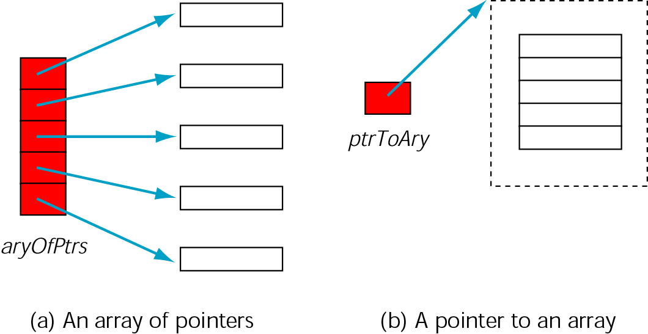
Figure 10-12 Array of pointers vs. Pointer to Array

Slide 83
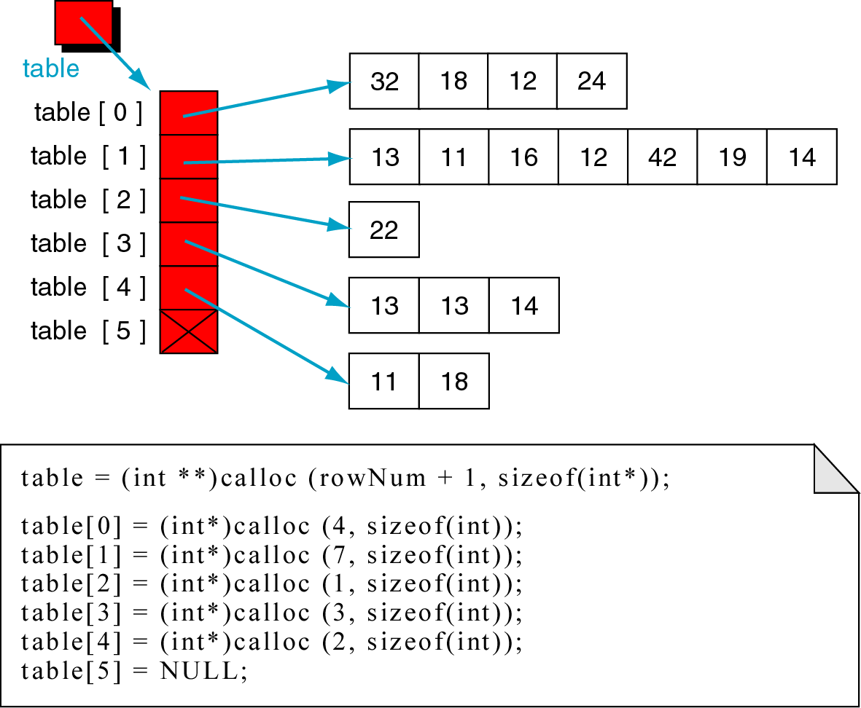
Figure 10-20 A Ragged Array
int ** table;

Slide 84
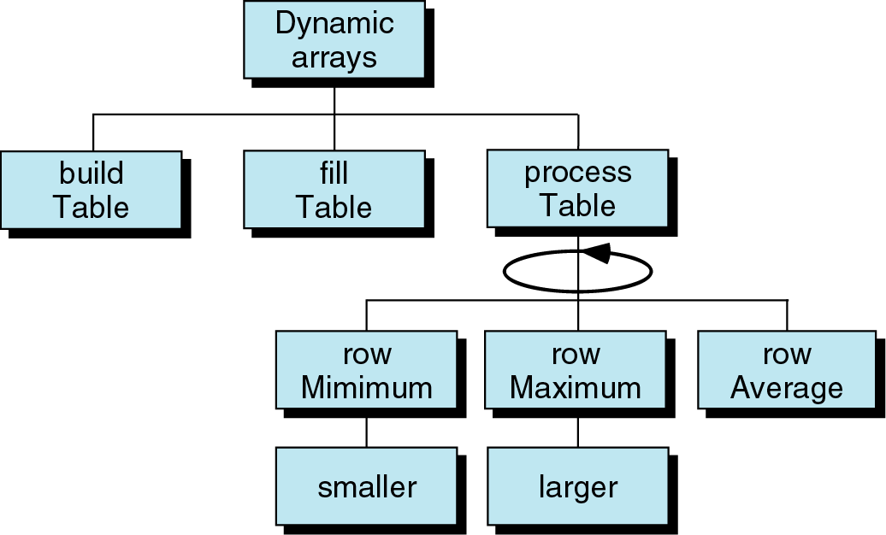
Figure 10-22

Slide 85
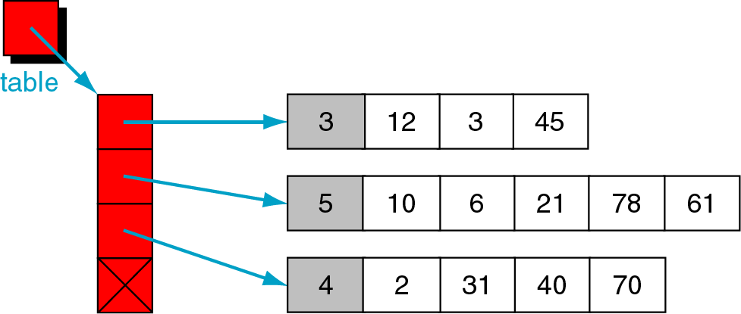
Figure 10-23 ragged array structure

Slide 86
Lab Problem: Construct a ragged array
The table pointer points to the first pointer in an array of pointers.
Each array pointer points to a second array of integers, the first element of which is the number of elements in the list.
A sample ragged array structure is shown next

Slide 87
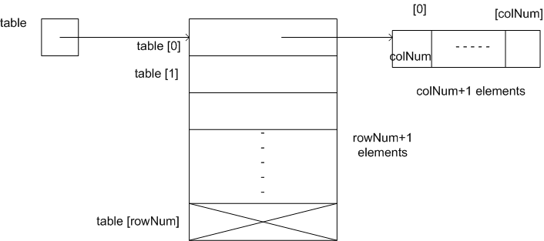
Lab Problem: Construct a ragged array

Slide 88
Lab Problem: Construct a ragged array
step 1: Declare a ragged array as a variable table.
step 2: Ask the user for row size and set a variable – rowNum
step 3: Allocate space for (rowNum+1) pointers as row pointers. The last row pointer will hold NULL
step 4: Ask the user for column size and set a variable – colNum

Slide 89
Lab Problem: Construct a ragged array
step 5: Allocate space for (colNum+1) data elements. The first element will hold value contained in colNum itself.
step 6: Repeat step 3 for all rows
step 7 : Display ragged array contents.

Slide 90
Lab Problem: Construct a ragged array
# include<stdio.h>
# include<stdlib.h>
int main(){
int rowNum, colNum, i, j;
int **table;
printf("\n enter the number of rows \n");
scanf("%d", &rowNum);
table = (int **) calloc(rowNum+1, sizeof(int *));
for (i = 0; i < rowNum; i++) /* this will tell which row we are in */
{
printf("enter size of %d row", i+1);

Slide 91
Lab Problem: Construct a ragged array
scanf("%d", &colNum);
table[i] = (int *) calloc(colNum+1, sizeof(int));
printf("\n enter %d row elements ", i+1);
for (j = 1; j <= colNum; j++)
{
scanf("%d", &table[i][j]);
}
table[i][0] = colNum;
printf("size of row number [%d] = %d", i+1, table[i][0]); }

Slide 92
Lab Problem: Construct a ragged array
table[i] = NULL;
for (i = 0; i < rowNum; i++) /* this will tell which row we are in */
{
printf("displaying %d row elements\n", i+1);
for (j = 0; j <= *table[i]; j++)
{
printf("%5d", table[i][j]);
}
printf("\n");
}
return 0; }

Slide 93
Lab Problem: Construct a ragged array
Sample input and output:
enter the number of rows: 3
enter size of row 1: 4
enter row 1 elements: 10 11 12 13
enter size of row 2: 5
enter row 2 elements: 20 21 22 23 24
enter size of row 3
enter row 3 elements: 30 31 32
displaying
10 11 12 13
20 21 22 23 24
30 31 32

Slide 94
END

